Slide 1
Controlling PowerPoint Presentations Using Voice Commands
Multimodal Interaction
Mariana Perna 108067 | Sara Almeida 108796
Notes:
Sara Good morning, everyone. Today, we’ll explore how voice commands can revolutionize the way we interact with presentations. As technology evolves, multimodal interfaces are becoming increasingly relevant, offering more natural ways to control systems. But, does voice truly enhance the experience, or could it end up being just another unnecessary feature? Let’s dive in and find out.

Slide 2
Introdução
Esta aula é uma seca
Esta aula é uma seca, preferia estar em casa

Slide 3

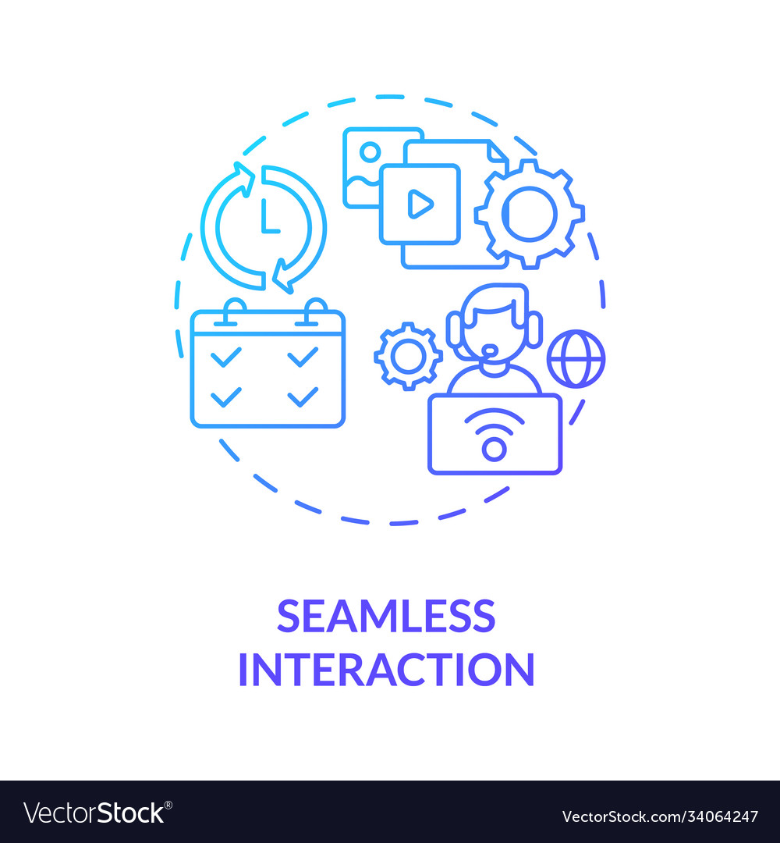
Project Objective
01
02
Develop a system to control PowerPoint via voice commands in European Portuguese
Provide simple and intuitive interaction and feedback for presenters
Notes:
Sara The objective of our project is to develop a system that allows presenters to control their PowerPoint slides using voice commands in European Portuguese. The key goal is to create a natural and intuitive interaction, with timely feedback to support the presenter’s flow. The big question we aim to answer is: how do we make this system as smooth and reliable as possible?

Slide 4

Multimodal Interaction Challenges
Accent
Accent and language variability
Low latency
Feedback
Minimizing latency for real-time use
Providing non-intrusive feedback
Notes:
Sara Multimodal interaction presents its own set of challenges. These include handling linguistic variability, ensuring minimal latency, and providing feedback that doesn’t distract the presenter. But most importantly, what determines whether users will actually accept and adopt such a system?

Slide 5
Technologies Overview
Microsoft Speech SDK
RASA NLU
Microsoft Office Interop API
For voice recognition and synthesis
For Natural Language Understanding (NLU) and command interpretation
For PowerPoint control and automation
https://www.nuget.org/packages/Microsoft.Office.Interop.PowerPoint/ https://learn.microsoft.com/pt-pt/javascript/api/powerpoint?view=powerpoint-js-preview
Notes:
Sara

Slide 6
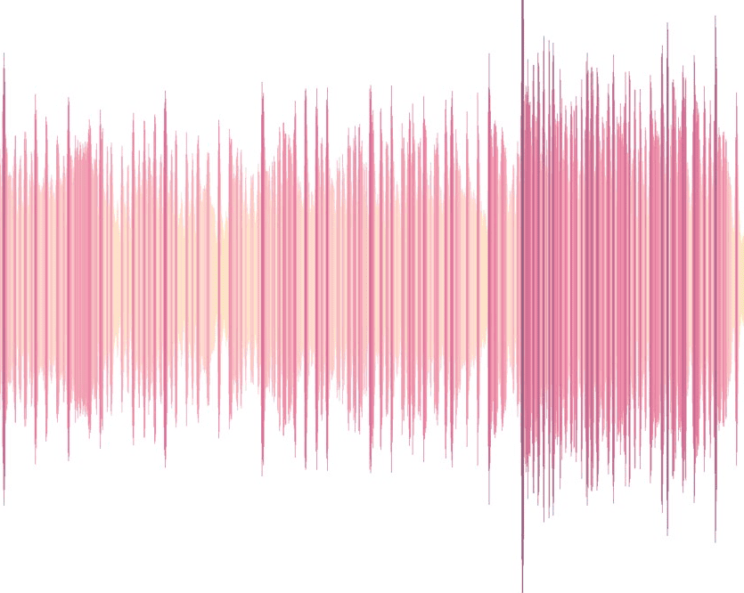
_______
Wake word
______
Features
“Olá PowerPoint!”
Set of actions, commands and feedback
Notes:
Mariana
Our system interaction starts with a wake word, ‘Olá PowerPoint!’ This activates the listening mode, ready to process commands. We’ve designed several features to streamline presentations, each with specific actions, voice commands in Portuguese, and immediate feedback. Let’s take a closer look at these features.

Slide 7
Features
01
02
Start Presentation
Resume Presentation
Command: "Vamos dar início à apresentação"
Feedback: "Iniciando a apresentação"
Command: "Vamos fazer uma pausa rápida" ; "Terminar a apresentação"
Feedback: "A encerrar a apresentação"
Notes:
Mariana Starting with one of the core features, we have the ability to initiate a presentation using voice commands. By simply saying, ‘Vamos dar início à apresentação,’ the system will trigger the slideshow. The system will confirm this action by saying: ‘Iniciando a apresentação.’ This ensures that the presenter can begin smoothly without manual interaction. Next, we have the pause and resume functionality. During a presentation, the presenter might need to pause or end the session. Commands such as ‘Vamos fazer uma pausa rápida’ or ‘Terminar a apresentação’ can be used here. The system provides feedback like ‘A encerrar a apresentação.’ This keeps the flow structured while maintaining control.

Slide 8
Features
03
04
Move to the Next Slide
Go Back to the Previous Slide
Command: "Passa para o slide seguinte." ; "Avança para o tópico seguinte."
Feedback: Move to the next slide.
Command: "Volta ao slide anterior" ; "Volta ao tema passado"
Feedback: Move back to the previous slide.
Notes:
Mariana To advance through the presentation, we can use commands like ‘Passa para o slide seguinte’ or ‘Avança para o tópico seguinte.’ This is one of the most frequently used features. The system confirms the action with a notification: ‘Move to the next slide.’ This ensures smooth navigation without distracting the presenter. Sometimes, a presenter might need to revisit a previous point. Using commands like ‘Volta ao slide anterior’ or ‘Volta ao tema passado,’ the system allows seamless navigation to the previous slide. The feedback here is straightforward: ‘Move back to the previous slide.’ This ensures the presenter knows they’re on the right slide.

Slide 9
Features
05
06
Zoom In on a Slide Element
Zoom Out to Original Size
Command: "Aumenta a imagem" ; "Focar na imagem"
Feedback: Zoom applied on image
Command: "Diminui a imagem", "Voltar ao tamanho original",
Feedback: Zoom reset.
Notes:
Mariana When presenting detailed graphics or charts, the ability to zoom in can be crucial. By saying ‘Aumenta a imagem’ or ‘Focar na imagem,’ the system will enlarge the selected element. ‘Zoom applied on image,’ ensures clarity for the audience. To reset the view, the presenter can use commands like ‘Diminui a imagem’ or ‘Voltar ao tamanho original.’ The system then restores the slide to its original state, accompanied by feedback: ‘Zoom reset.’ This allows for transitions between detailed and general views.

Slide 10
Features
07
08
Jump to a Slide by Title
Jump to a Slide by Number
Command: "Passa para o slide da Arquitetura"
Feedback: "Analisando o slide da Arquitetura"
Command: "Ver o slide 8"
Feedback: "Analisando o slide 8"
Notes:
Mariana Jumping directly to a specific slide by its title is another useful feature. We only need to say ‘Passa para o slide da Arquitetura.’ The system will locate and display the requested slide. The feedback message ‘Analisando o slide da Arquitetura’ confirms accuracy, helping the presenter stay on track. Similar to the previous feature, we can navigate directly to a slide using its number. A command like ‘Ver o slide 8’ takes the presenter there instantly. The feedback ‘Analisando o slide 8’ confirms the selection, providing reassurance that the correct slide is displayed.
MOVER PARA SECTIONS (se nao der tempo por nome) Ler os headers com a api
Injetar como uma lista
Para depois reconhece-lo

Slide 11
Features
09
10
Highlight Specific Elements
Activate Presenter View
Command: "Sublinhar a frase “...” "
Feedback: "Sublinhando a frase “...” "
Command: "Preciso das minhas notas"
Feedback: Presenter view enabled.
Notes:
Mariana Sometimes, it’s important to emphasize specific content on a slide. By saying ‘Sublinhar a frase...,’ the system highlights the desired element. Feedback such as ‘Sublinhando a frase...’ keeps the presenter informed, ensuring key information is emphasized.
Lastly, we have the presenter view. This feature is critical for providing additional notes and guidance during a presentation. By using the command ‘Preciso das minhas notas,’ the system activates presenter mode. A notification ‘Presenter view enabled’ confirms this, offering the presenter enhanced control.
Please hihtlited the sentence initiated by : “” “”

Slide 12
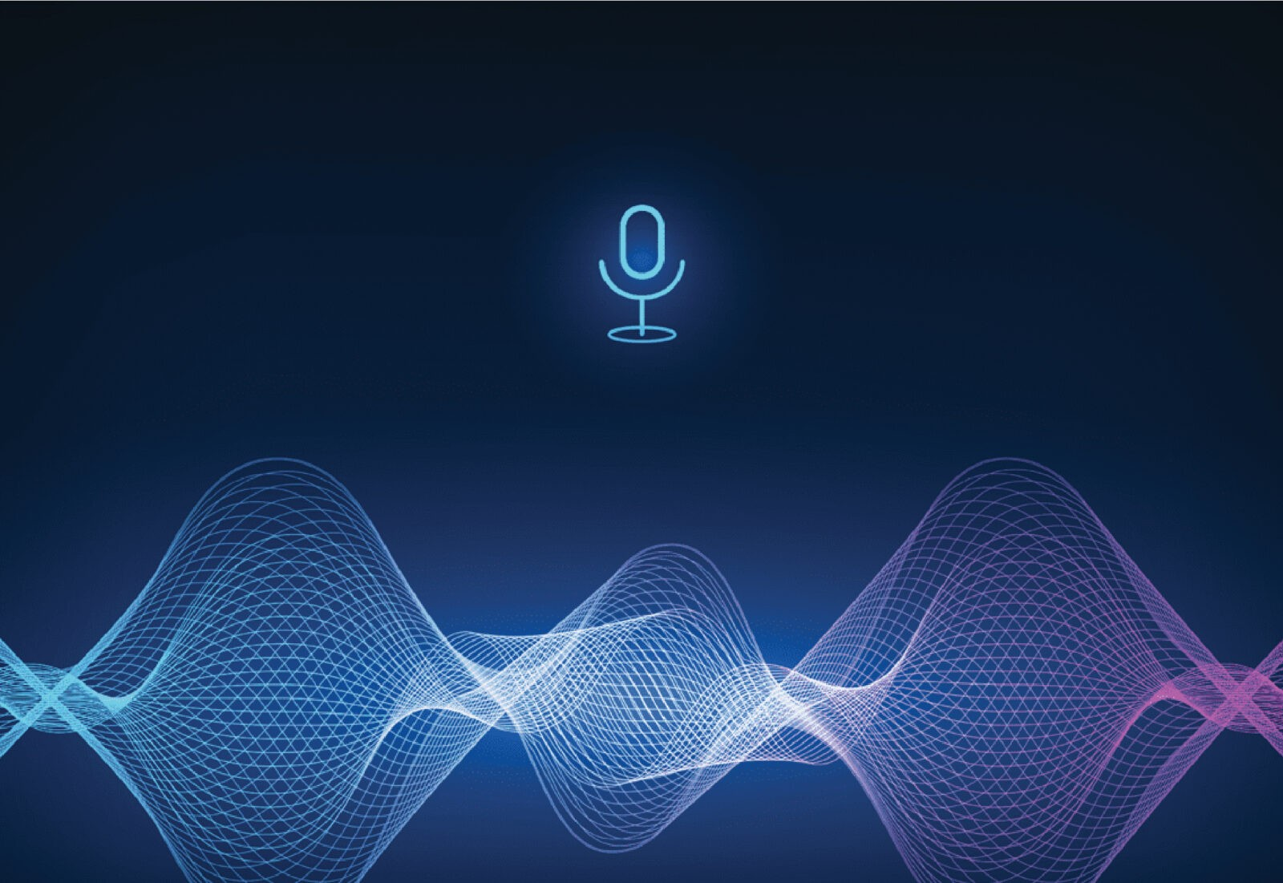
Benefits of the System
Natural and intuitive control
Hands-free operation
Notes:
Sara Our system offers natural, hands-free control, enabling presenters to focus on their audience.

Slide 13
Thanks!
Any doubts?
Notes:
Sara

